Slide 1
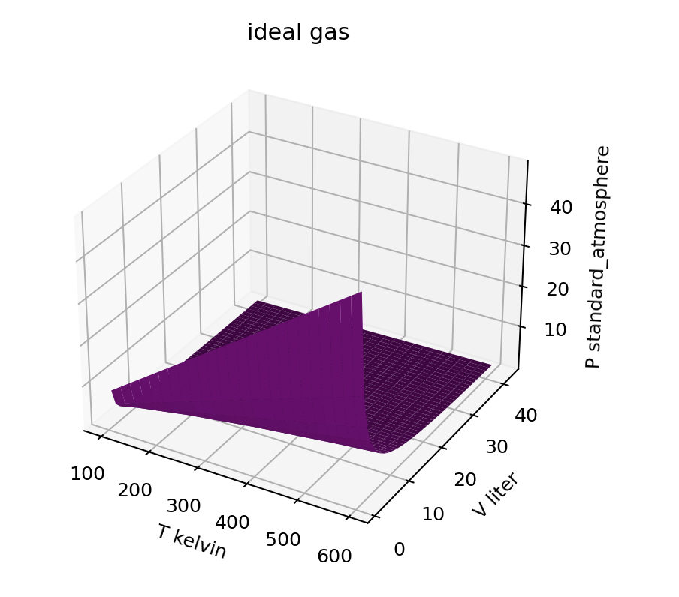
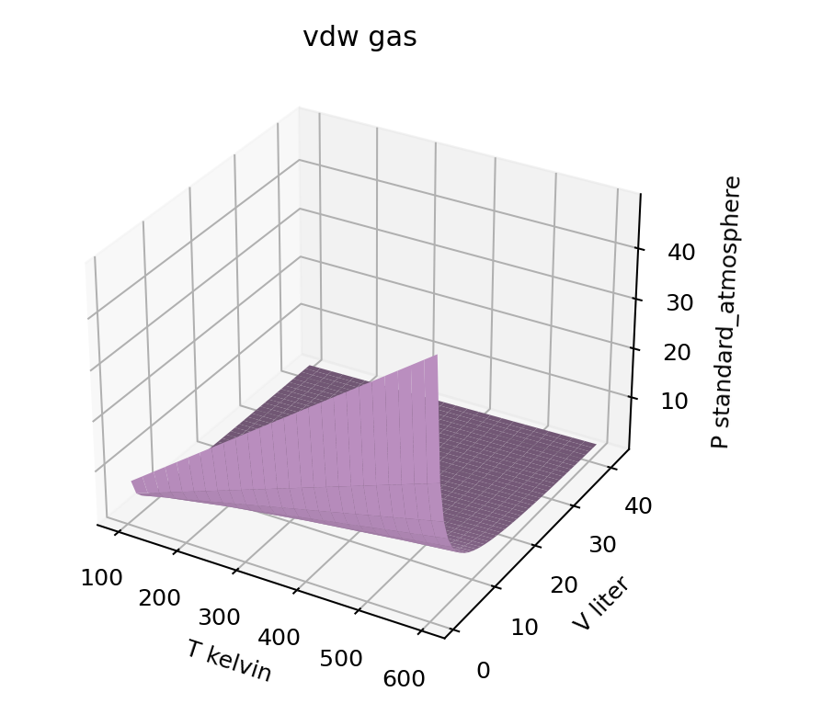
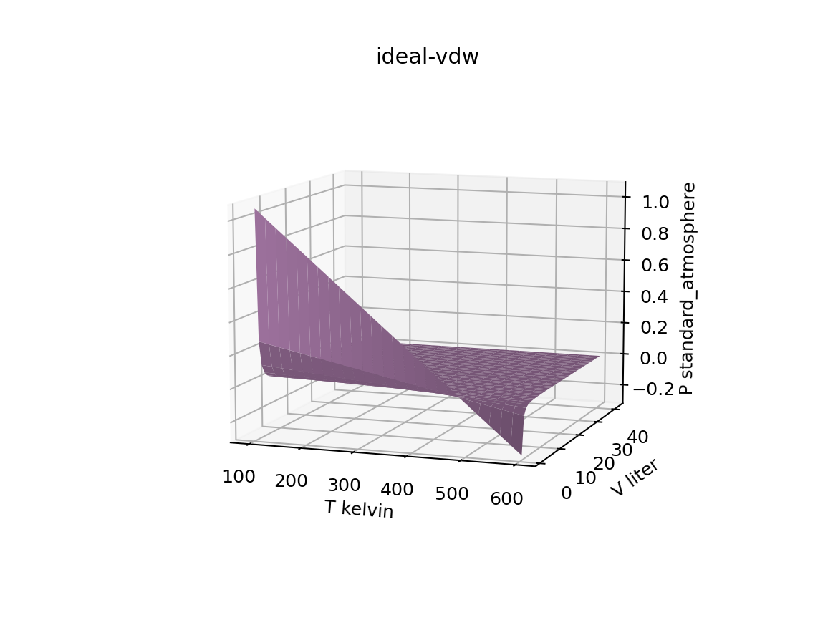


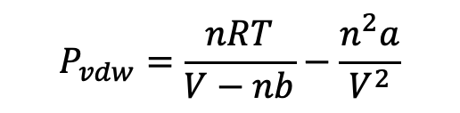
Week 1 – We learned how to manipulate (add, subtract) entire surfaces
$$P_{ideal}=\frac{nRT}{V}$$
$$P_{vdw}=\frac{nRT}{V−nb}−\frac{n^{2}a}{V^{2}}$$
$P_{ideal}$- $P_{vdw}$
-
=

Slide 2
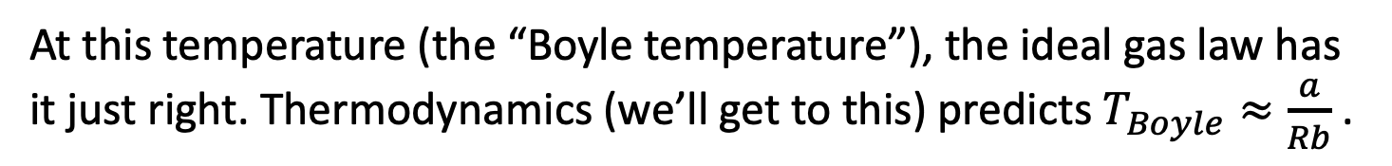

Week 1 – How to use visualizations as an analysis tool
Let’s assume vdw’s equation ($P=\frac{nRT}{V−nb}−\frac{n^{2}a}{V^{2}}$) is more accurate than the ideal gas law (a great assumption). Then differences tell us about deficiencies in assumptions of the ideal gas law.
$P_{ideal}$- $P_{vdw}$
Ideal pressure is too big (real gases have lower pressure)
Ideal pressure is too low (real gases have higher pressure)
At this temperature (the “Boyle temperature”), the ideal gas law has it just right. Thermodynamics (we’ll get to this) predicts $T_{Boyle}≈\frac{a}{Rb}$ .

Slide 3
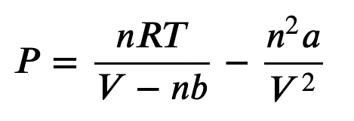
Week 1 – How vdw theory thinks about those parameters
“a” is a measure of intermolecular attraction. If molecules are attracted to one another, they’ll tend to hit the wall less hard and less often, resulting in lower pressure.
“b” is a measure of molecular size. Big molecules will bump into each other more, and therefore hit the wall harder and more often, resulting in higher pressure.
Intermolecular forces

Slide 4
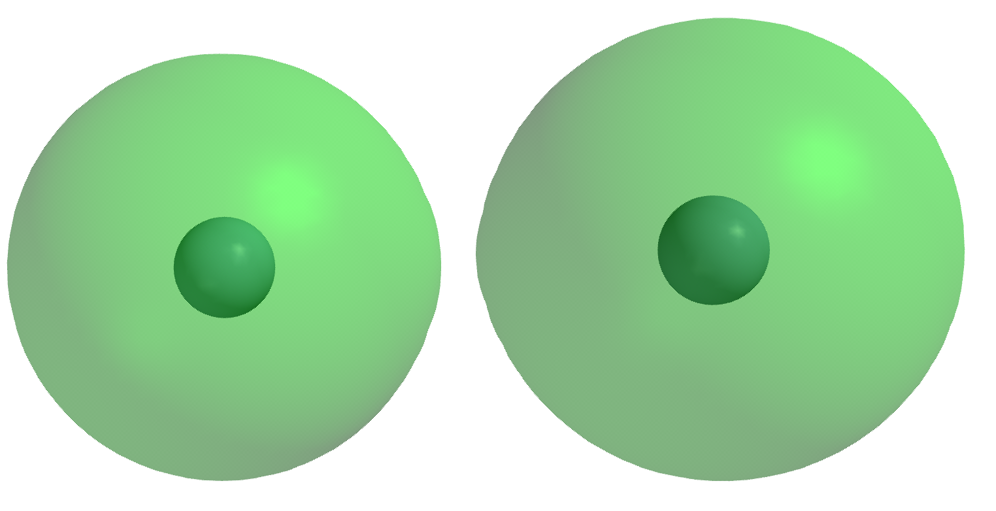
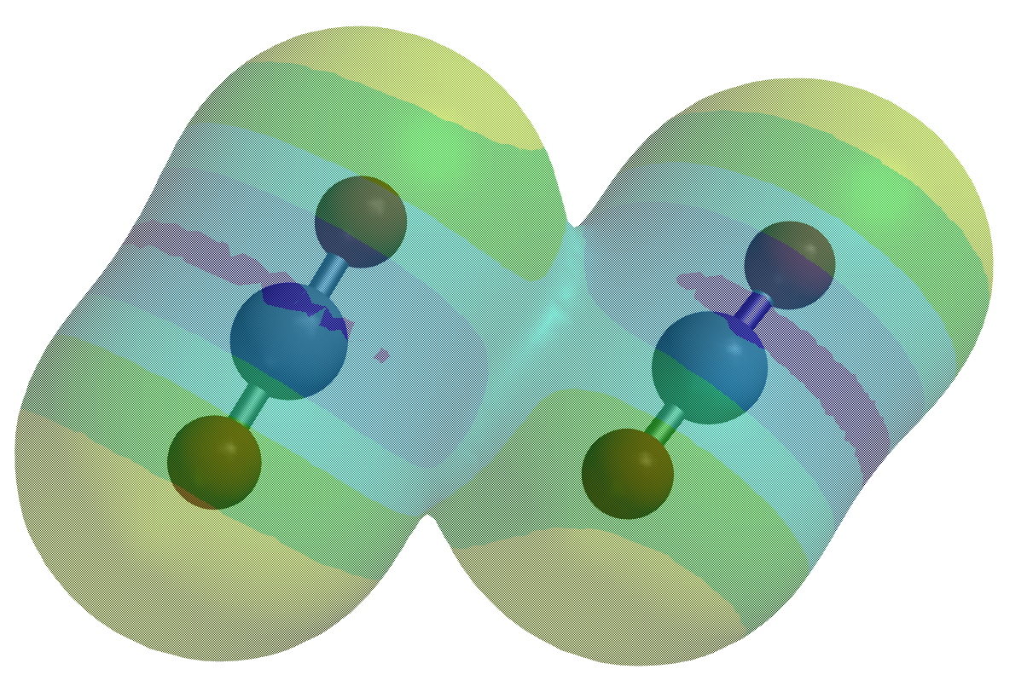
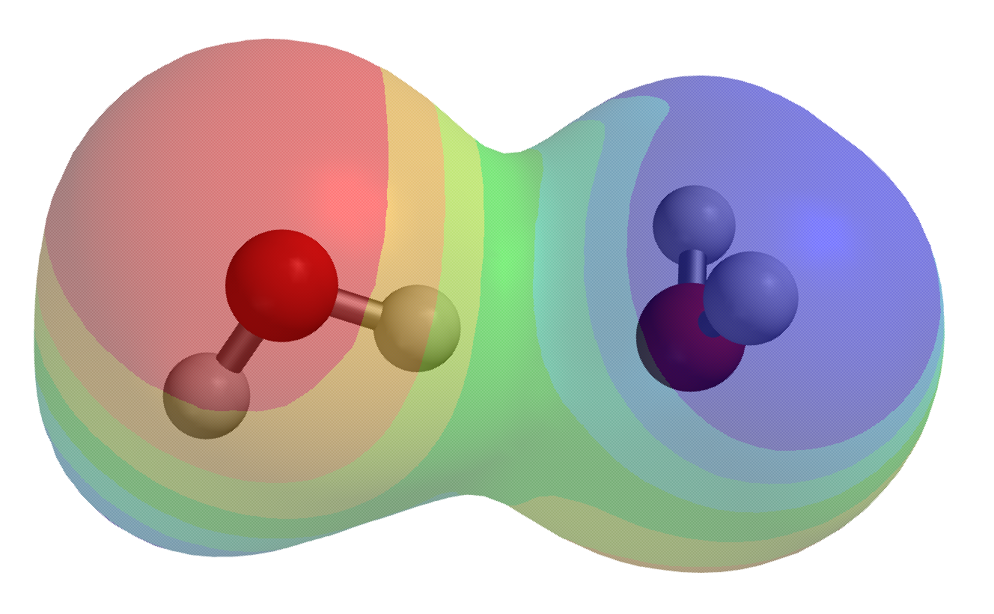
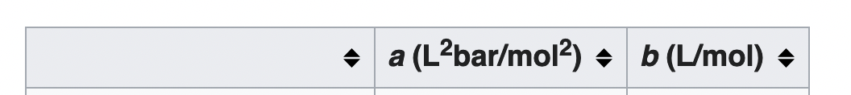
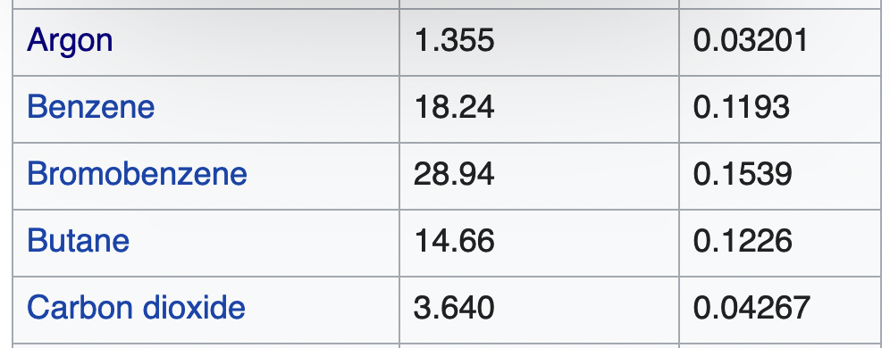
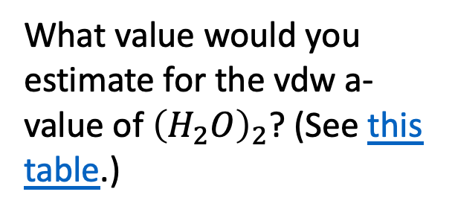
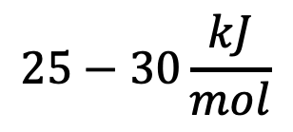
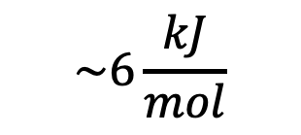
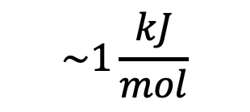
Week 1 – Relating intermolecular bond strengths to vdw “a” value
$$\sim 1\frac{kJ}{mol}$$
$$\sim 6\frac{kJ}{mol}$$
$$25−30\frac{kJ}{mol}$$
What value would you estimate for the vdw a-value of ${\left(H_{2}O\right)}_{2}$? (See this table.)

Slide 5
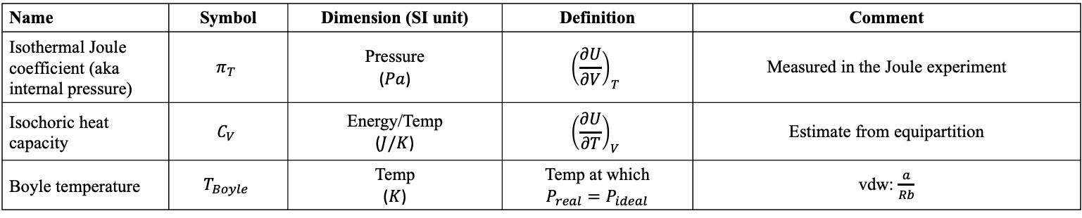
Week 1 – Summary of measurable quantities
Name | Symbol | Dimension (SI unit) | Definition | Comment
Isothermal Joule coefficient (aka internal pressure) | $$π_{T}$$ | Pressure ($Pa$) | $${\left(\frac{∂U}{∂V}\right)}_{T}$$ | Measured in the Joule experiment
Isochoric heat capacity | $$C_{V}$$ | Energy/Temp ($J/K$) | $${\left(\frac{∂U}{∂T}\right)}_{V}$$ | Estimate from equipartition
Boyle temperature | $$T_{Boyle}$$ | Temp ($K$) | Temp at which $$P_{real}=P_{ideal}$$ | vdw: $\frac{a}{Rb}$

Slide 6
The kind of question I might ask – Variables with units (in Python)
Use AssignQuantity to define the variable $R=8.314×{10}^{−3}\frac{kJ}{mol K}$
Notes:
Week 1

Slide 7
The kind of question I might ask – Variables with units (in Python)
Use AssignQuantity to define the variable $R=8.314×{10}^{−3}\frac{kJ}{mol K}$
R = AssignQuantity(8.314e-3,’kJ/(mol K)’)
Notes:
Week 1

Slide 8
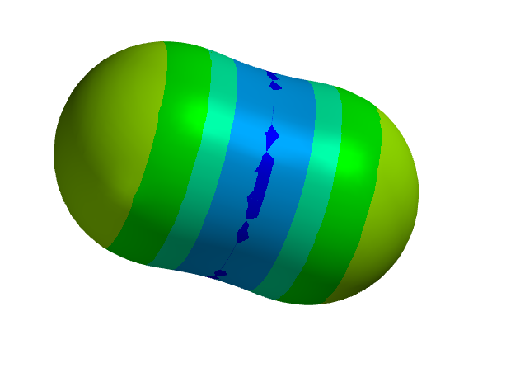
The kind of question I might ask – Intermolecular bond strengths, part 1 (Spartan)
What’s the meaning of the colors in this electrostatic potential map of $CO_{2}$?
Notes:
Week 1

Slide 9
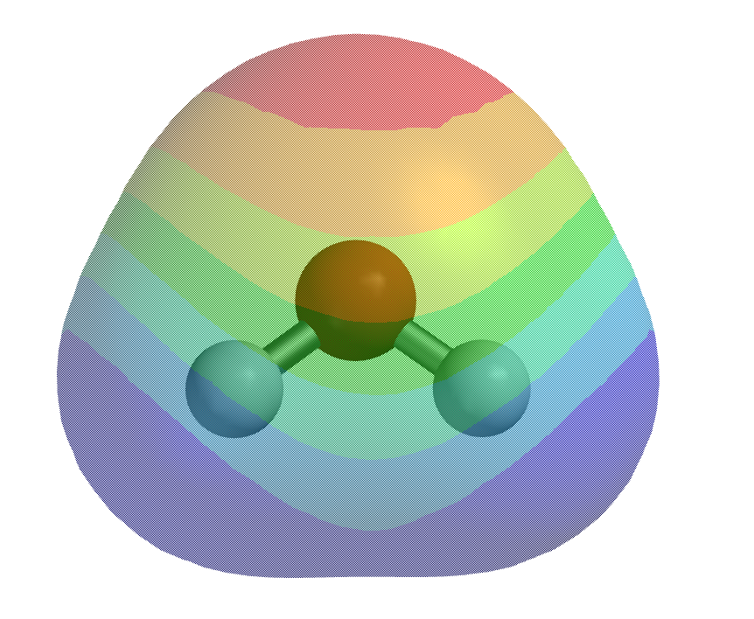
The kind of question I might ask – Intermolecular bond strengths, part 2 (Spartan)
How would you use Spartan to get the bond strength holding two water molecules together?
Notes:
Week 1

Slide 10
The kind of question I might ask – Intermolecular bond strengths, part 2 (Spartan)
How would you use Spartan to get the bond strength holding two water molecules together?
$$E_{bond}=2E_{monomer}−E_{dimer}$$
Notes:
Week 1

Slide 11
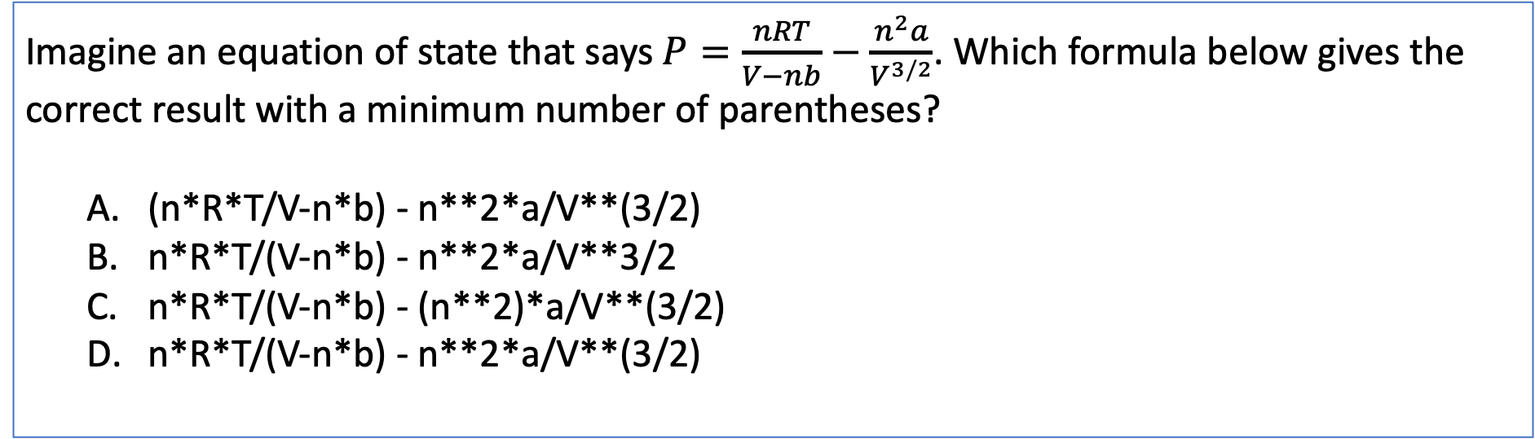
The kind of question I might ask – Order of operations
Imagine an equation of state that says $P=\frac{nRT}{V−nb}−\frac{n^{2}a}{V^{3/2}}$. Which formula below gives the correct result with a minimum number of parentheses?
(n*R*T/V-n*b) - n**2*a/V**(3/2)
n*R*T/(V-n*b) - n**2*a/V**3/2
n*R*T/(V-n*b) - (n**2)*a/V**(3/2)
n*R*T/(V-n*b) - n**2*a/V**(3/2)
Notes:
Week 1

Slide 12
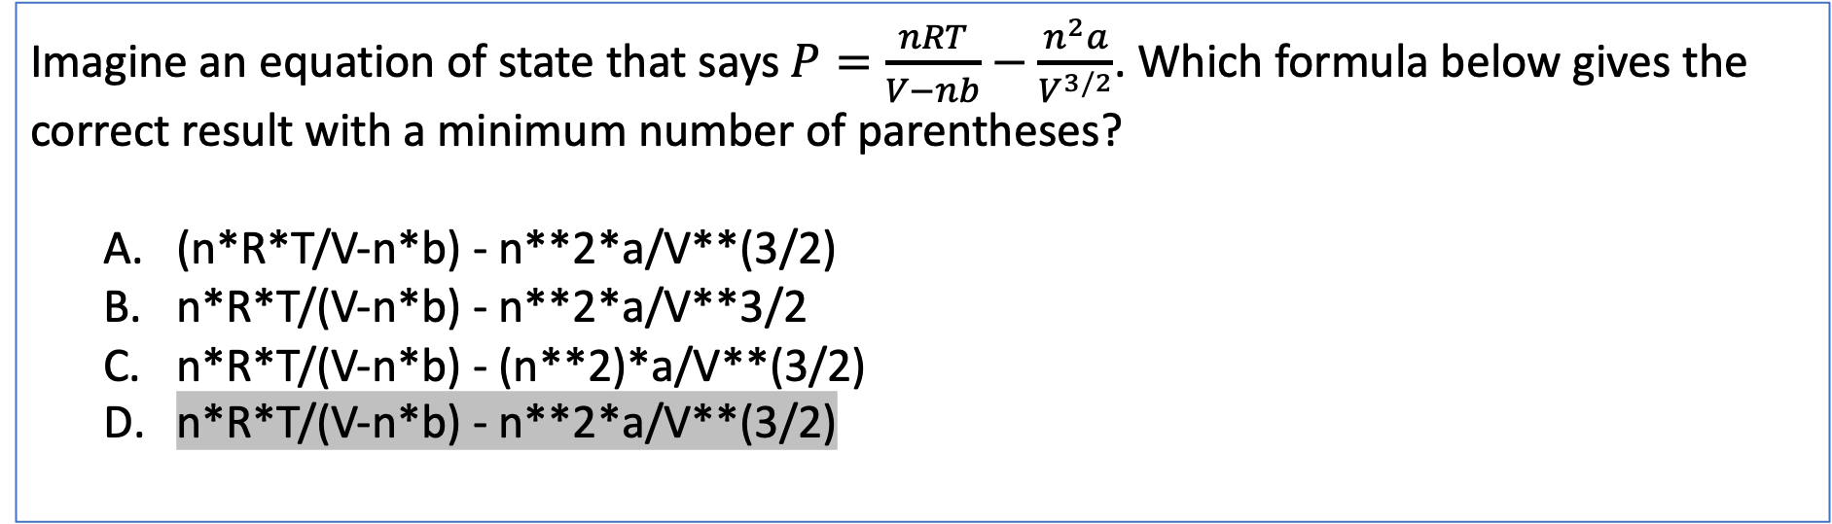
The kind of question I might ask – Order of operations
Imagine an equation of state that says $P=\frac{nRT}{V−nb}−\frac{n^{2}a}{V^{3/2}}$. Which formula below gives the correct result with a minimum number of parentheses?
(n*R*T/V-n*b) - n**2*a/V**(3/2)
n*R*T/(V-n*b) - n**2*a/V**3/2
n*R*T/(V-n*b) - (n**2)*a/V**(3/2)
n*R*T/(V-n*b) - n**2*a/V**(3/2)
Notes:
Week 1

